Slide 1
Transaction Cost Theory: Past Progress, Current Challenges, and Suggestions for the Future
Ilya R. P. Cuypers
Jean-Francois Hennart
Brian S. Silverman
Gokhan Ertug
The Academy of Management Annals 15(1): 111–50 (2021)

Slide 2
Overview
The current “problem” facing TCT:
Success → Potential fragmentation + confusion
Roadmap for navigating TCT literature + Suggestions for future conceptual and empirical work:
Assumptions, theoretical constructs, and logic
Evolution of literature: Strategy and IB contributions
Three conceptual areas for future research
Three phenomenological areas for future research

Slide 3
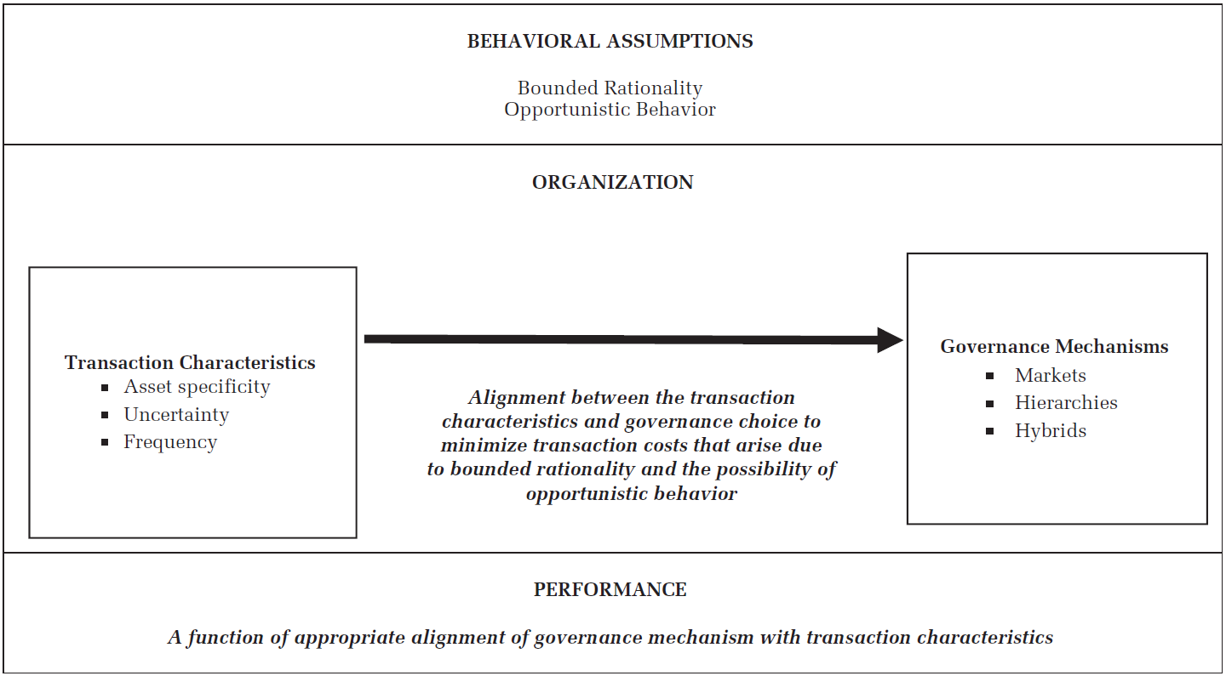
Williamson’s TCT Framework

Slide 4
Behavioral Assumptions
 | Issues | Opportunities for future research
Bounded Rationality | Limited focus on behavioral aspects | Work on heuristics, attention, risk preferences, and biases to better understand the incorporation and perception of behavioral uncertainty in decision-making analyses
 | Theoretical tension arises from differing interpretations of the extent of bounded rationality | Understand why and when firms make governance decisions that align with TCT prescriptions, as well as when they make suboptimal choices
Opportunism | Overly pessimistic view of human nature | IB literature proposes bounded reliability as a less extreme version of opportunism
 | Incomplete integration of behavioral insights regarding the opportunism assumption | Incorporate insights from behavioral economics and psychology to understand how decision-makers perceive potential opportunistic behavior and how it influences their governance choices

Slide 5
Transaction Characteristics: Asset Specificity
Issues | Opportunities for future research
Overlooked details of asset specificity settings and characteristics of investments | Identify asset specificity types relevant to the specific context and their influence on governance choices
Secondary data on R&D and marketing intensity used as proxies for asset specificity | Use finer-grained data at the firm or transaction level, and more precise proxies for asset specificity
Primary or survey data often fail to capture the essence of the asset specificity construct | Collect data on investment's residual value and potential quasi-rents at risk
Examinations mostly focused on asset-specific investments from a single party's perspective | Include all asset-specific investments from every party involved in the exchange
Insufficient exploration of how digital transformation and economic trends affect asset specificity conceptualizations | Assess how these trends may redefine categories within the asset specificity construct

Slide 6
Transaction Characteristics: Uncertainty
Issues | Opportunities for future research
Lack of systematic categorization of factors influencing behavioral uncertainty | Categorize mechanisms associated with behavioral uncertainty
Unclear guidelines on using objective versus subjective measures of behavioral uncertainty | - Establish how firms should make decisions from a TCT perspective → objective measures - Explain deviations from TCT predictions or actual decision-making based on TCT logic → perceptual measures

Slide 7
Transaction Characteristics: Frequency
Issues | Opportunities for future research
- Frequency underexplored in empirical research - Variation in operationalization: continuous vs. binary measures yield different results | More work is needed that systematically considers the effect of frequency
Difficulty separating cost amortization favoring hierarchy from other mechanisms advocating non-hierarchy | Use more refined empirical methods to support better identification of the effects of frequency

Slide 8
Governance Modes and Mechanisms
Markets, hierarchies, and hybrids
Markets: price mechanism
Hierarchies: administrative control
Hybrids: different combinations of price- and administration-based mechanisms
Relational governance
A third type of governance mechanism
A set of social mechanisms that influence behavioral uncertainty within the TCT framework

Slide 9
TCT Logic
A pluralistic view: Different versions of TCT have evolved
Strategy: market failure and appropriability
International business: behavioral uncertainty and why firms might fail

Slide 10
TCT Logic
A more dynamic TCT
Fundamental transformation: anticipation of a shift from large-number to small-number conditions ex post should drive governance choices ex ante
Role of managers’ foresight and understanding
Investigate the adaptation of governance modes over time

Slide 11
TCT: The Logic
Less focus on the performance implications of strategic choices
Two approaches to investigate performance implications:
Use of sophisticated empirical approaches
Focus on predicted tradeoffs in performance that are associated with a governance choice, and then to seek evidence supporting or refuting these tradeoffs
Two important considerations for research design:
Endogeneity of the governance choice
Survival bias

Slide 12
Future research
Conceptual areas:
Further integration of research in strategy, IB, and institutional economics
Link to sociology: Trust–opportunism and formal–informal organization
Link to psychology and behavioral economics: behavioral processes that frame the governance of transactions
Phenomenological areas:
Technological advances: Platforms and governance
Technological advances: AI and machine learning
Nonpecuniary goals: Nationalism; Sustainability and CSR; Government action via public–private partnerships; Grand challenges

